Slide 1

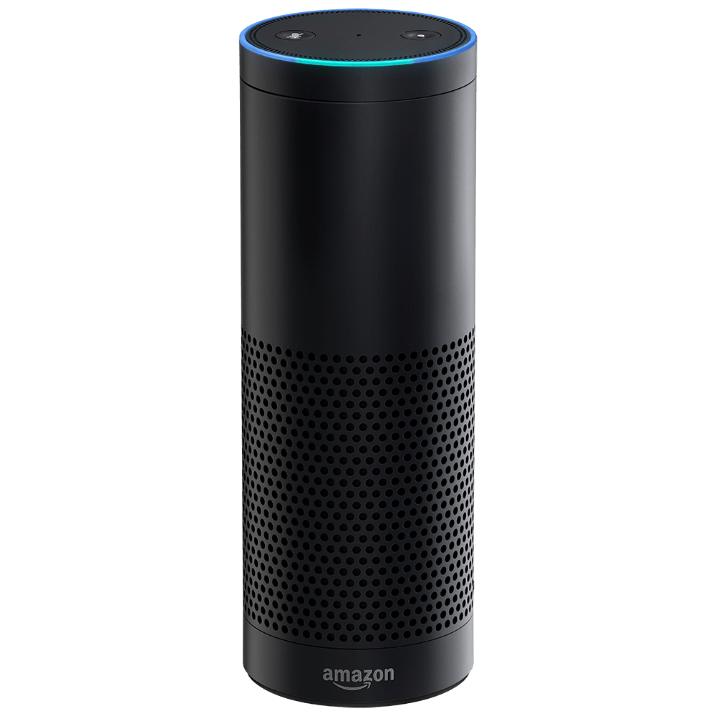

Alexa Skills- Towards Building a Customized Personal Assistant
By:
Reda Mastouri

Slide 2
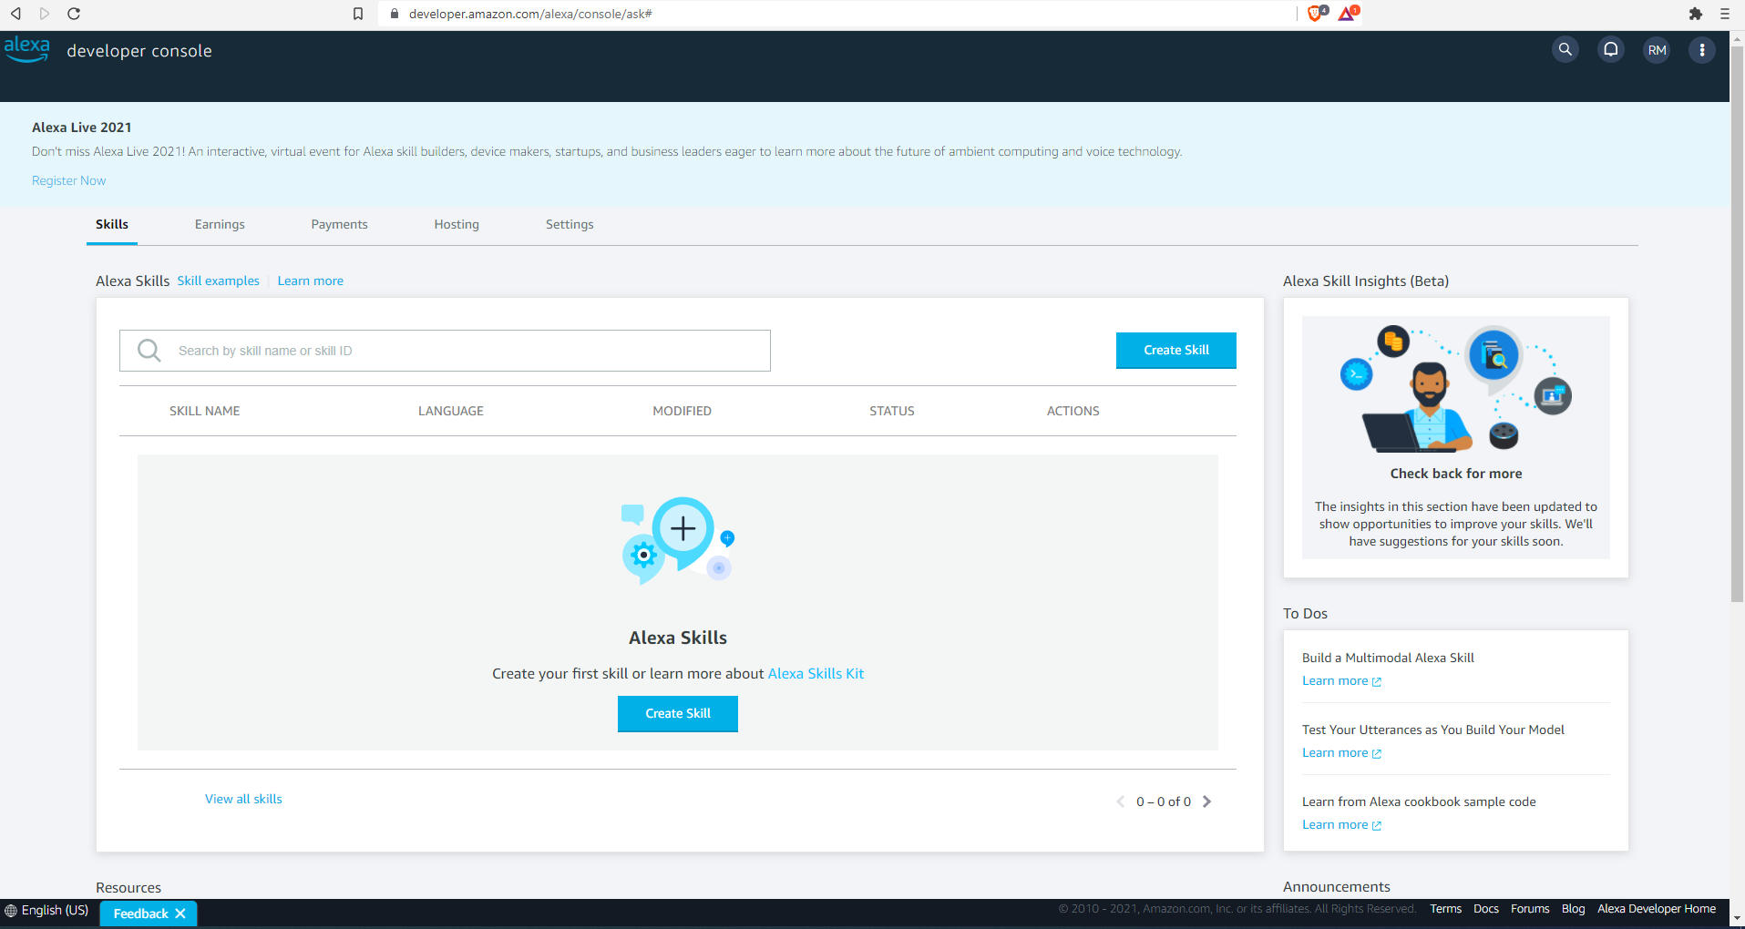
Getting Started
Creating a developer account on Alexa Developer Console Portal:
https://developer.amazon.com/alexa/console/ask#
- Skill Configuration
- Intents
- Slots
- Utterances
Skill Testing:
- Lambda Test Events
- Developer Portal Skill Simulator
- Alexa App
- Amazon Echo -Hardware

Slide 3
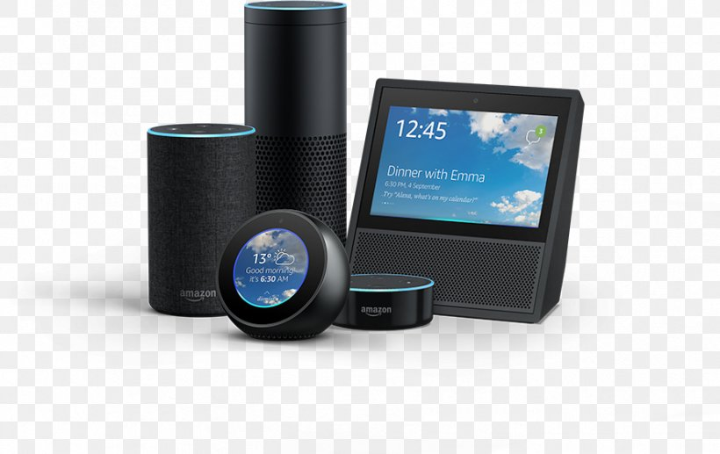
What is Alexa Skills?
Alexa is a voice service from Amazon.
Alexa powers devices like Echo Show, Echo Spot, Echo Dot etc.
The most important feature of the Alexa is off course it’s hands-free voice control, which lets users ask questions without touching the device.
Alexa listen to the voice commands and respond with appropriate responses to fulfill.
Alexa comes with many capabilities like playing music, reading the news, creating your shopping list, setting alarms, know about the weather etc.
Alexa comes with many capabilities like playing music, reading the news, creating your shopping list, setting alarms, know about the weather etc.

Slide 4
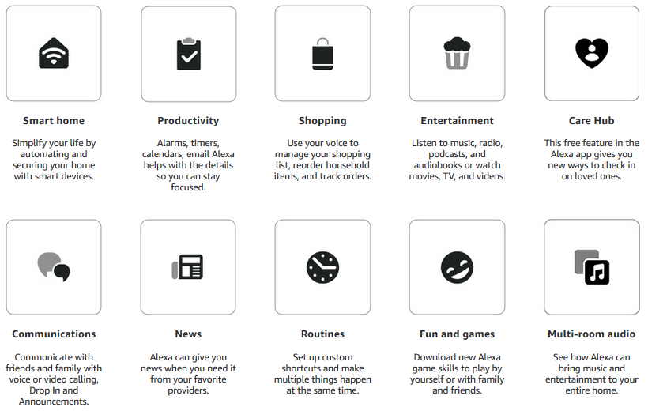
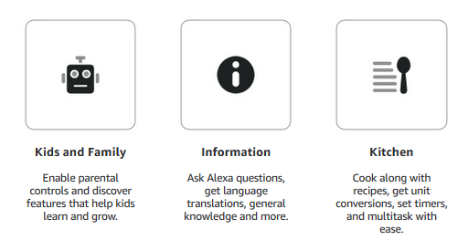
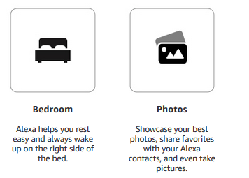
Alexa Features

Slide 5
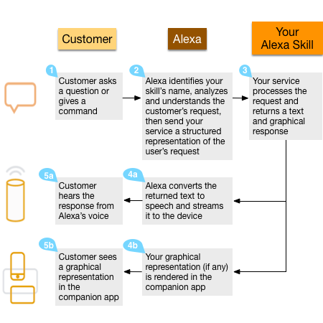

How Alexa Skills Work? (Part I)
Wake word When users say ‘Alexa’ which wakes up the device. The wake word put the Alexa into the listening mode and ready to take instructions from users. Of Course you can change the wake word via Alexa assistant mobile app.
Invocation name Invocation name is the keyword used to trigger a specific skill. It just likes the name of that skill which we used to identify. Users can combine the invocation name with an action, command or question. All the custom skills need an invocation name to trigger or start it.
Utterance In the above example, the keyword ‘Taurus’ is an utterance. Utterances are phrases the users will use when making a request to Alexa. Alexa identifies the user’s intent from the given utterance and responds accordingly. So basically the utterance decide what user want Alexa to perform.

Slide 6
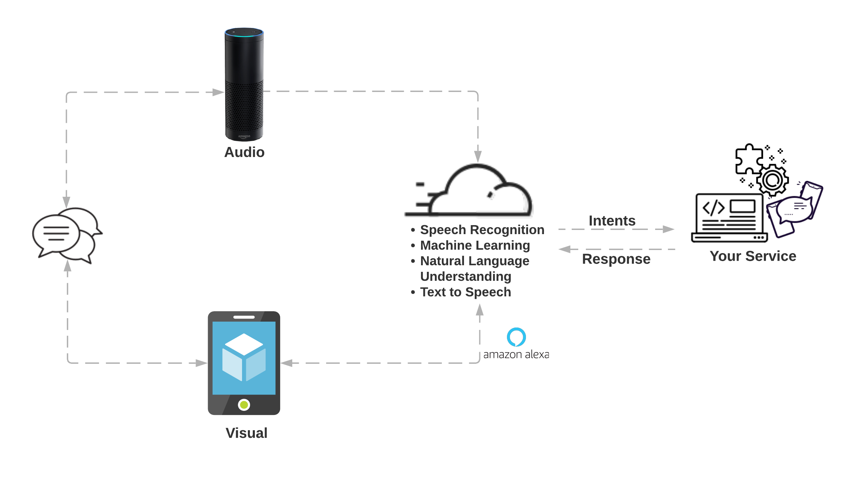
How Alexa Skills Work? (Part II)
Alexa enabled devices sends the user’s instruction to a cloud-based service called Alexa Voice Service (AVS). Think the Alexa Voice Service as the brain of Alexa enabled devices and perform all the complex operations such as Automatic Speech Recognition (ASR) and Natural Language Understanding (NLU).
Alexa Voice Service process the response and identify the user’s intent, then it makes the web service request to third party server if needed. This request is necessary if the Skills needs to fetch information from an external service. For example, Flash briefing skills need to interact with news website/server to fetch the latest headlines. From there, the Alexa service sends the response back to the Alexa and read it to the users.

Slide 7

How does FD benefit from developing an Alexa Skill? (Part I)
Digital assistants are quickly becoming a part of our lives. Amazon Alexa, Apple’s HomePod, Google Assistant, Microsoft Cortana, Samsung’s Bixby, and China’s Chumenwenwen and Xiaoice are just a few to mention.
Virtual assistants are fast becoming commonplace in the home through products like these, with more than 100 million Alexa-enabled devices having been sold till date.
Amazon has extended Alexa’s API so developers can build Alexa Skills, which are essentially third-party apps that take advantage of Alexa’s amazing capabilities.

Slide 8
How does FD benefit from developing an Alexa Skill? (Part II)
The Alexa Skills marketplace is rapidly growing, from 1,000 to 15,000 in just one year in the Alexa Skill Store, part of the reason that analysts estimate Alexa to become a $10 billion industry by 2020. For businesses, it’s time to get on board now to build with Alexa as it grows.
And there will be fight over talent skilled in Alexa Skills and other voice-assistant technologies.
With the expected meteoric growth, voice could become the primary way people interact with the internet in as little as 10–15 years.
The unprecedented opportunities are appealing not only to the owners of smart devices.
Having taken residence in millions of homes, Amazon and Google are paving the way for other brands that offer entertainment, information, goods, and services.

Slide 9
How does FD benefit from developing an Alexa Skill? (Part III)
The first advantage is the vast market. Amazon Echo family commands almost 72% market share of current U.S. smart speakers. Loyal users will likely fill their houses with compatible devices. With a legion of connected fridges, door locks, thermostats, lamps, and other appliances that may use Alexa Voice Service API, the potential of Alexa brand market penetration is infinite.
Your investment in the technology is safe. With Alexa controlling such a huge percentage of the marketplace already, it’s likely to maintain that lead for some time. Choosing to develop an Alexa Skills (rather than for another voice platform) simplifies development from both the product strategy and technical development standpoints. Keeping things simple at first means you don’t need to develop for 3–4 platforms at one time. You can develop for Siri, Cortana and the Google Assistant later as necessitated by the market.
Promoting more efficient sorting and accurate matching in the marketplace, AI platforms will be simultaneously winning people’s trust and loyalty.
At the moment, Amazon has tremendous incentive to help companies succeed with Alexa Skills and offers strong customer support for Skills development. This level of support will be likely to dissipate as the market grows.
The Alexa Skills platform will grow more complex. As the technology matures, so will expectations for features and functionality. Getting in early and developing a basic Skill gives you the opportunity to learn without much consequence and iterate as you mature. Right now, you’re not expected to have a completely mature Skill. There’s time to evolve as Alexa’s technology evolves. This will change, just as it did for mobile apps.
With voice being relatively new, it’s an incredible opportunity to beat your competitors to market with a compelling consumer experience that can differentiate you in your industry. Getting ahead of the curve means you won’t be scrambling to figure things out after your competitors have already done so.
As an added bonus, the companies that are first to market will be acknowledged as innovators and may receive a substantial amount of positive media attention.

Slide 10



Demo: Proof-of-Concept

Slide 11
Starting to build a Schedulify Skill: Checklist
Personal Assistant Bot:
Check financial portfolio
Manage servers
Send voice messages
Read out emails
Tell monthly goals
Build a publicly accessible Alexa Custom Skill & Monetize:
Schedulify

Slide 12
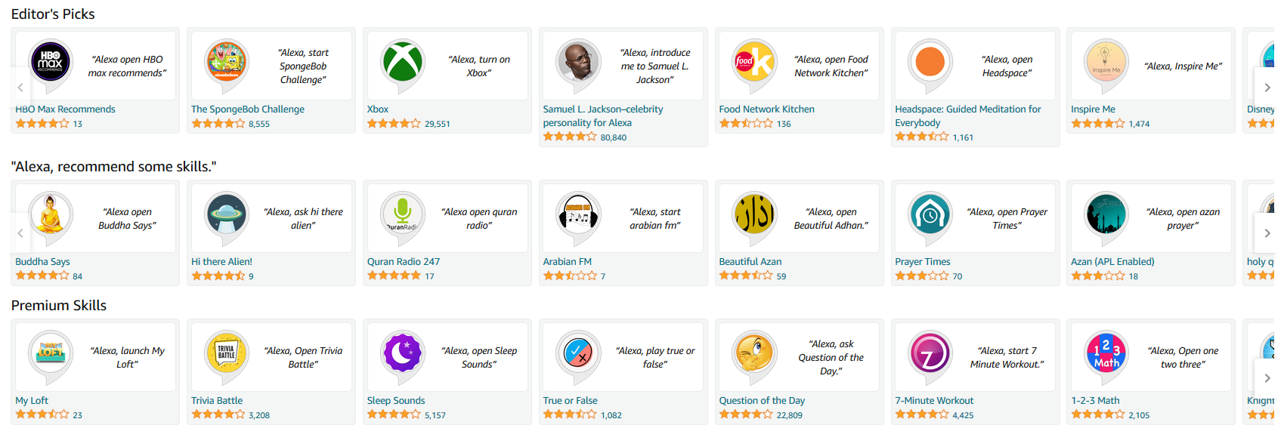
Starting to build a Schedulify Skill Example of available skills

Slide 13


Slide 14






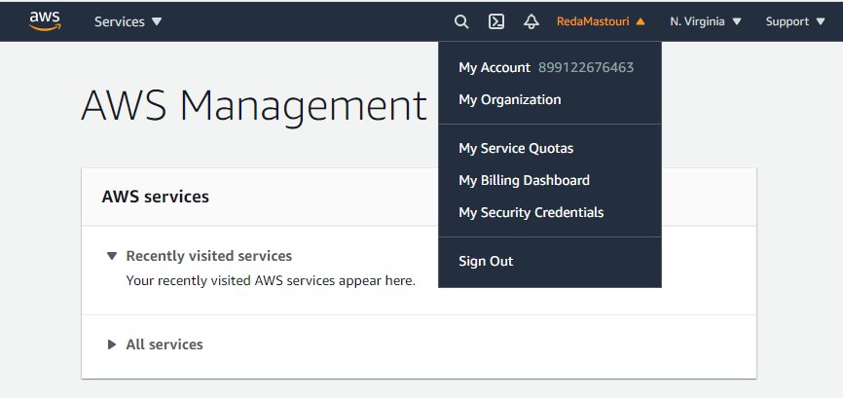
Working Environment: Cloud Computing

Slide 15
JavaScript Basics: Source-Code
https://github.com/technotablet/alexa-course-custom-skill.git
GitHub Repository https://github.com/technotablet/alexa-course-custom-skill
Checklist – Interactive, Web Based https://vivekk.com/teach-alexa-cs
Amazon S3 REST API Introduction http://docs.aws.amazon.com/AmazonS3/latest/API/
Alexa Built-in Slot Type Reference https://developer.amazon.com/docs/custom-skills/slot-type-reference.html
Alexa Built-in Intents https://developer.amazon.com/docs/custom-skills/standard-built-in-intents.html
Alexa Skills Kit (ASK) for Node.js (:tell, :ask, :tellWithCard etc. Response Methods) https://github.com/alexa/alexa-skills-kit-
sdk-for-nodejs Google Maps Directions API Documentation https://developers.google.com/maps/documentation/directions/intro
Time zones Syntax https://en.wikipedia.org/wiki/List_of_tz_database_time_zones

Slide 16
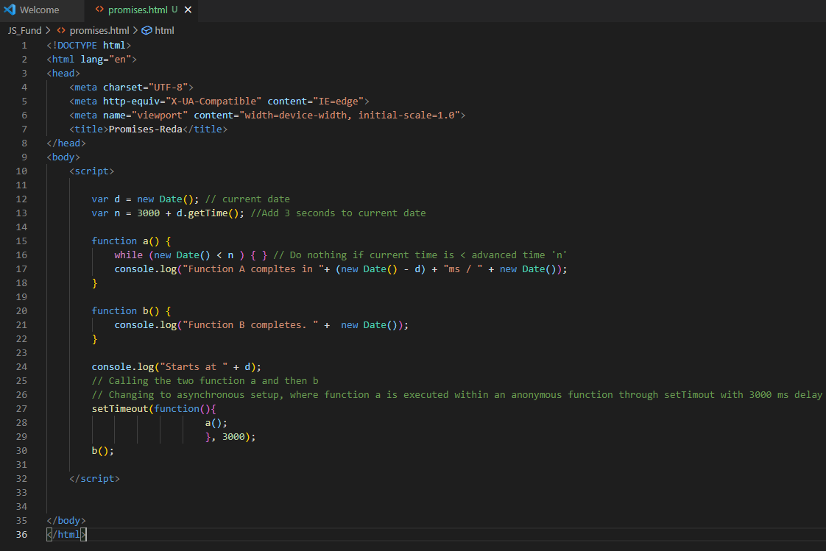
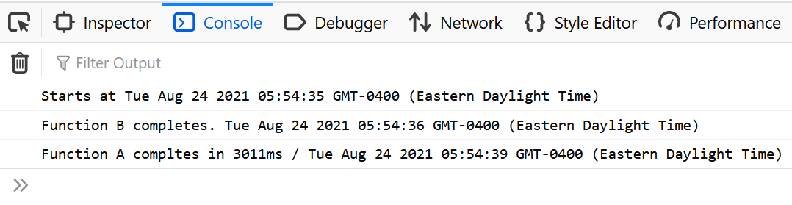
JavaScript Basics: JS101- Promises and Await Expressions in Async Functions- 2
Changing to asynchronous setup, where function a is executed within an anonymous function through setTimout with 3000 ms delay

Slide 17
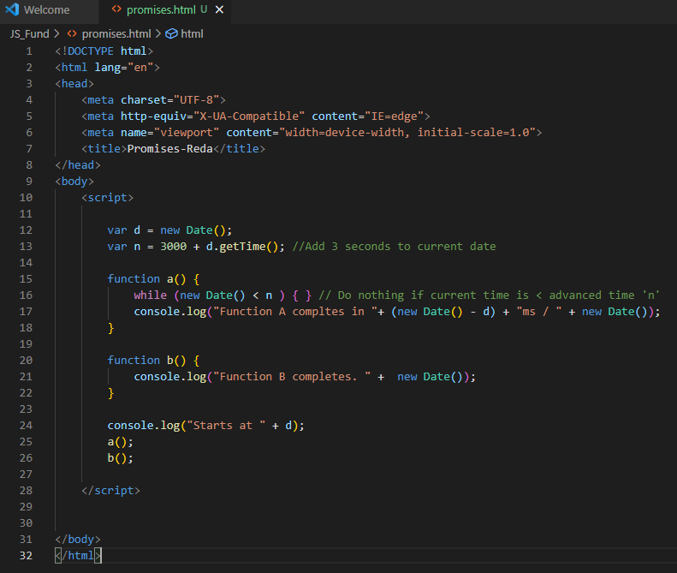
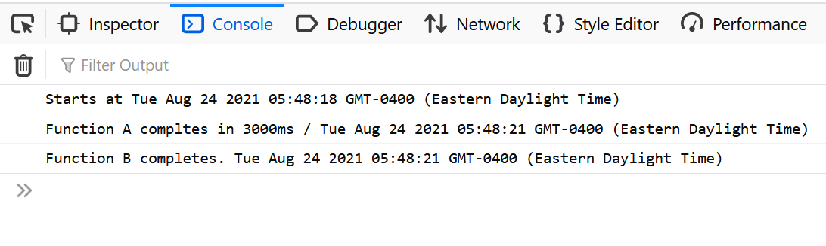
JavaScript Basics: JS101- Promises and Await Expressions in Async Functions- 2
setTimeout() is one of the earliest asynchronous methods in JS.
Pros:
Execute multiple functions in parallel
Non-blocking code
Cons:
Functions might be dependent on each other
One function’s output is another function’s imput

Slide 18
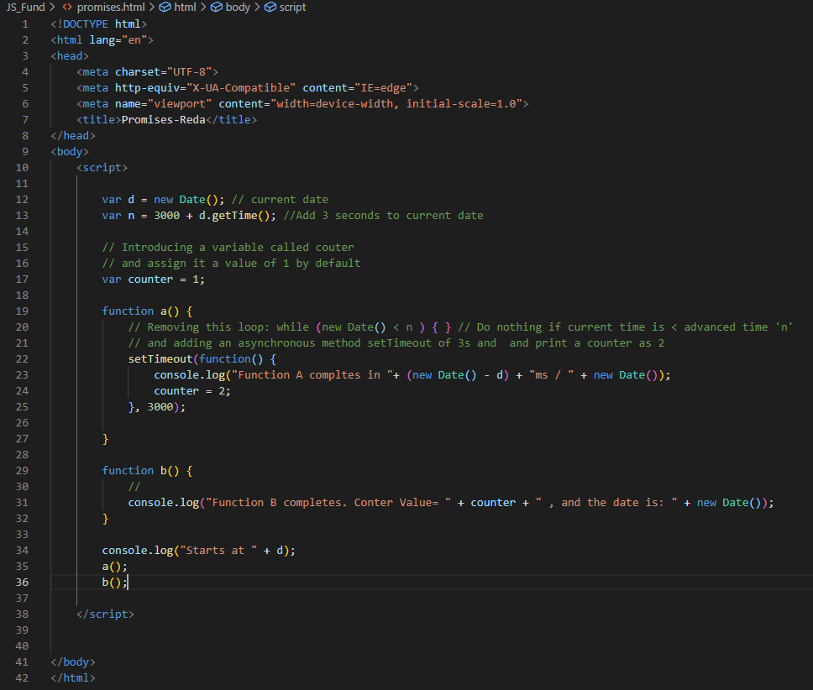
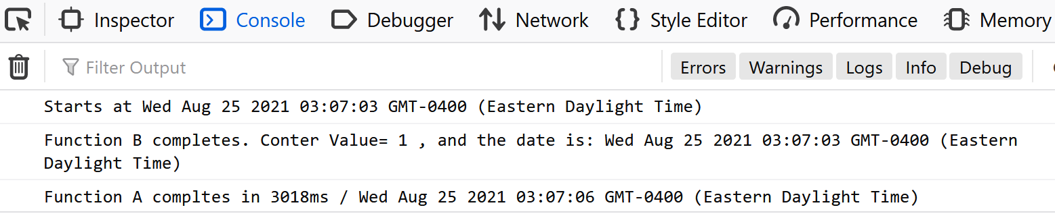
JavaScript Basics: JS101- Promises and Await Expressions in Async Functions- 3
Removing this loop: while (new Date() < n ) { } // Do nothing if current time is < advanced time 'n‘
and adding an asynchronous method setTimeout of 3s and and print a counter as 2

Slide 19
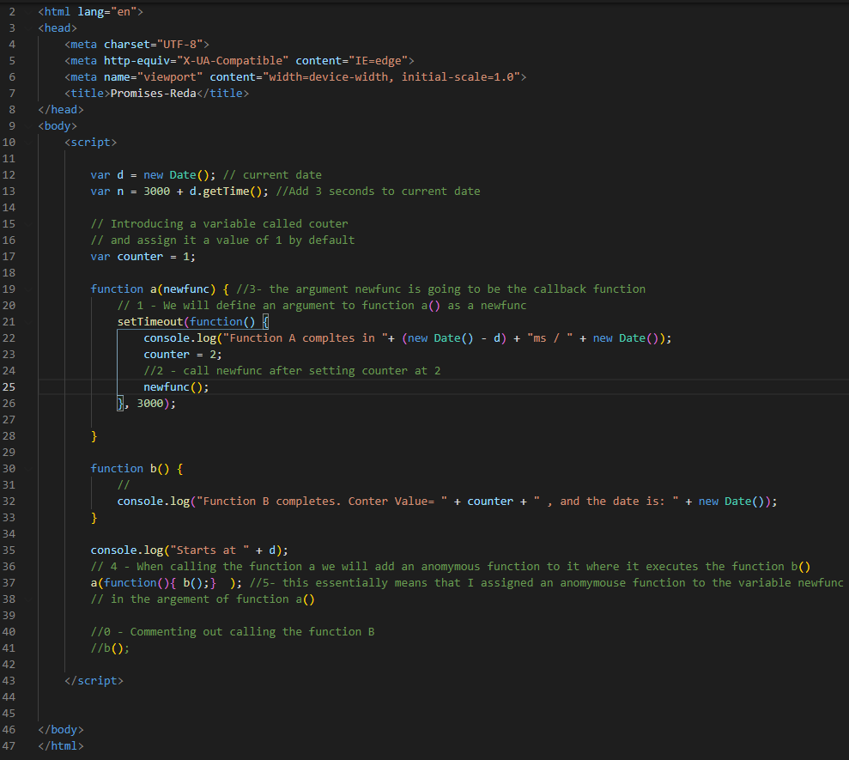
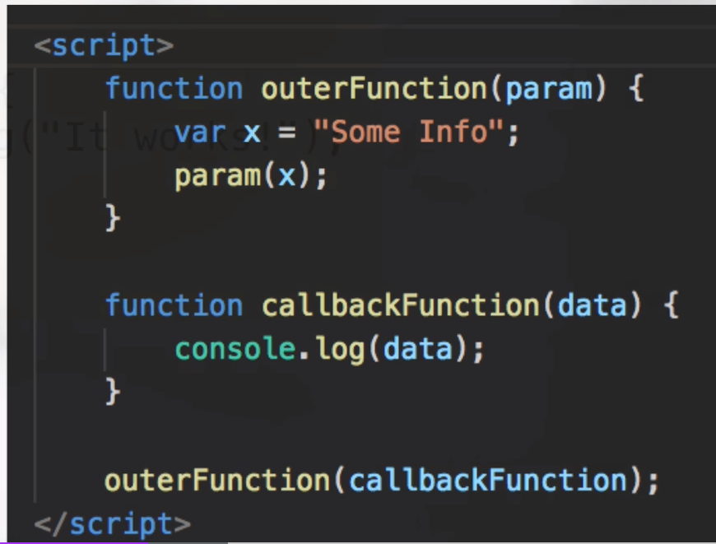
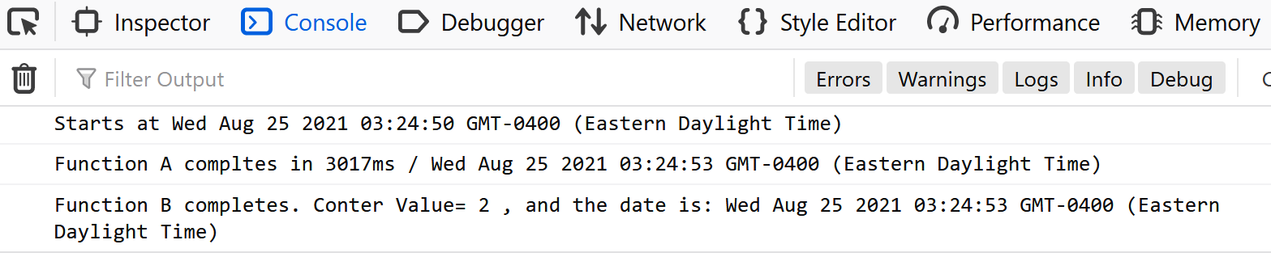
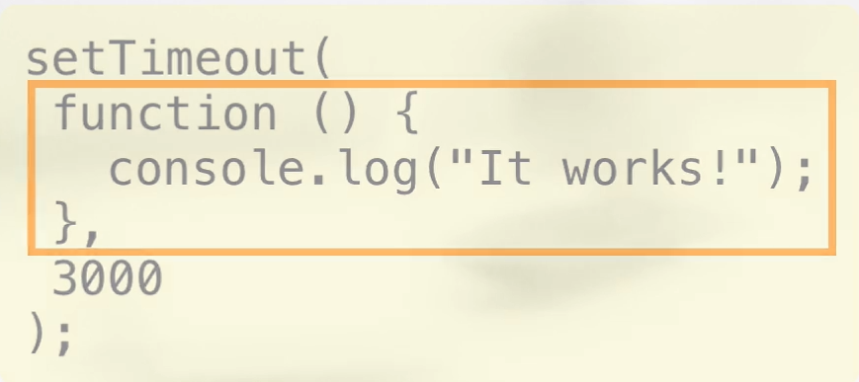
JavaScript Basics: JS101- Promises and Await Expressions in Async Functions- 4
A Callback is a function which is passed to another function as an argument
E.g. An anonymous function as an argument to setTimeout function
It let the code executes in a linear way

Slide 20
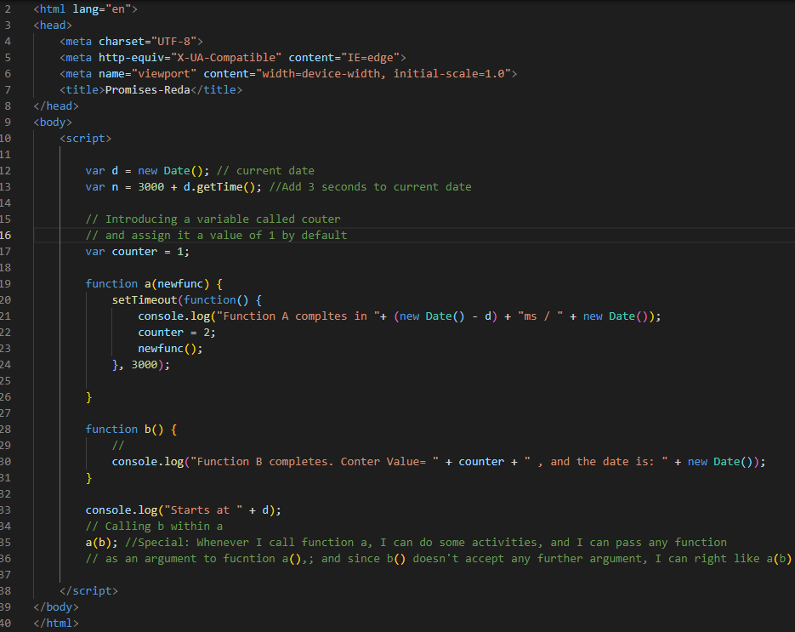
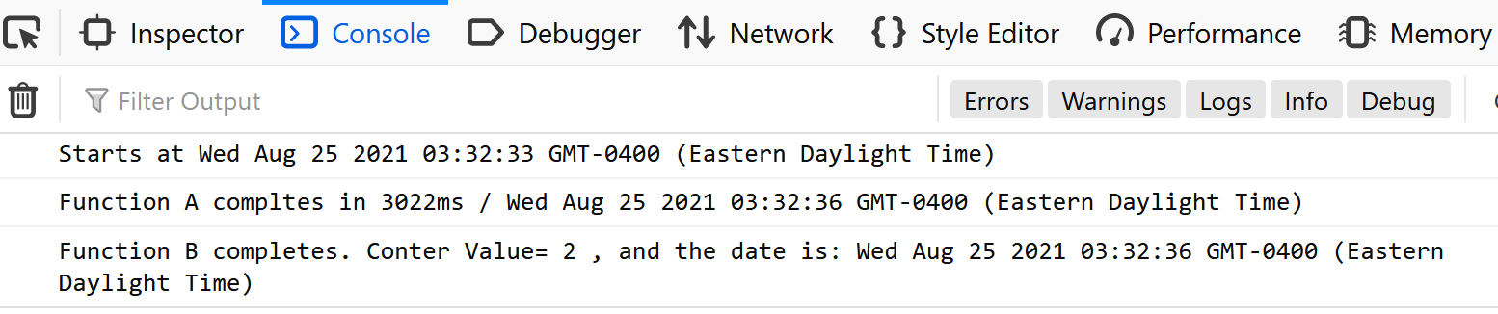
JavaScript Basics: JS101- Promises and Await Expressions in Async Functions - 5
Using asynchronous function in sequence

Slide 21
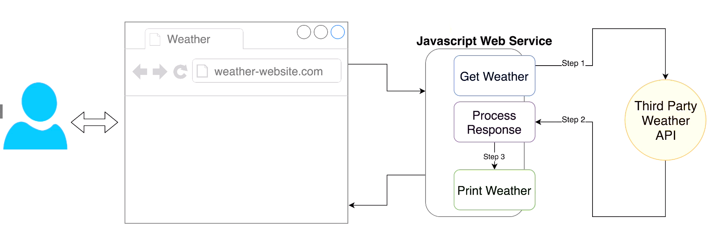
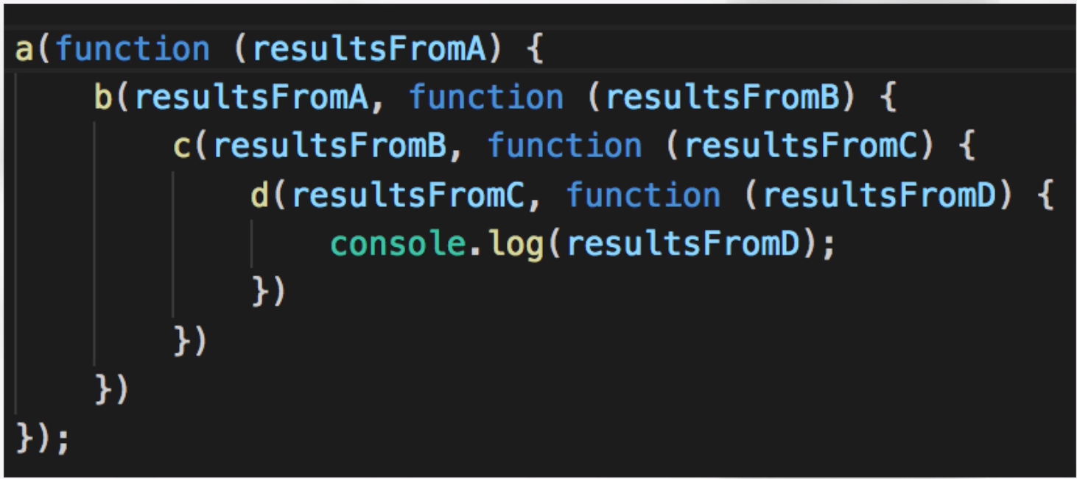
JavaScript Basics: Callback
Primarily used in Node.js 6.10 and below for Lambda
Establish connections to independent interfaces such as Databases or APIs
On response, process further (dependent functions)
If there are a large number of functions, dependent of each other, then we possibly get into something called Callback Hell (Because we need to nest the dependent functions, within a function). It can be very confusing and messy.

Slide 22
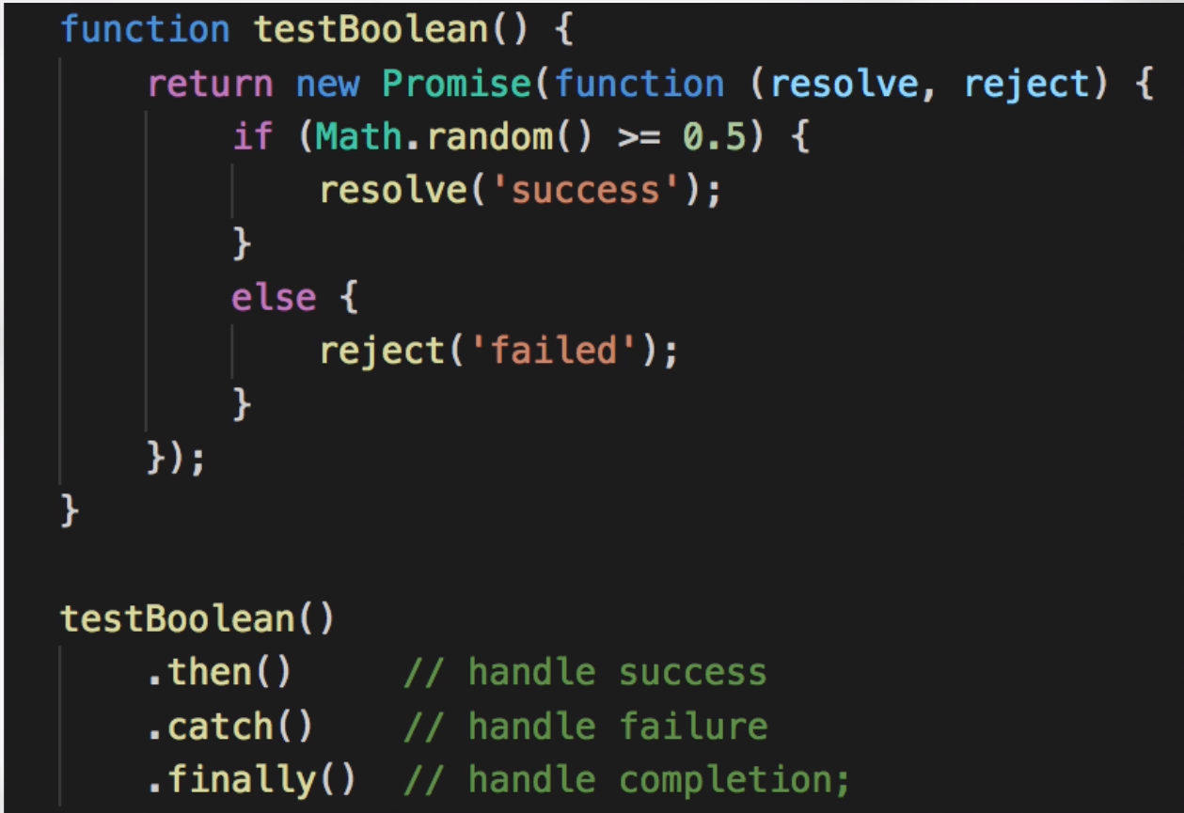
JavaScript Basics: Promises
Promise is a most sophisticated solution to implementing asynchronous code in JavaScript
It currently provides 3 methods
.then() : handles success and can manage both success and failure scenarios
.catch(): handles failure and meant for errors
.finally(): handles completion and meant for the tasks that should execute no matter what the result is (Executes irrespective of success or error)

Slide 23
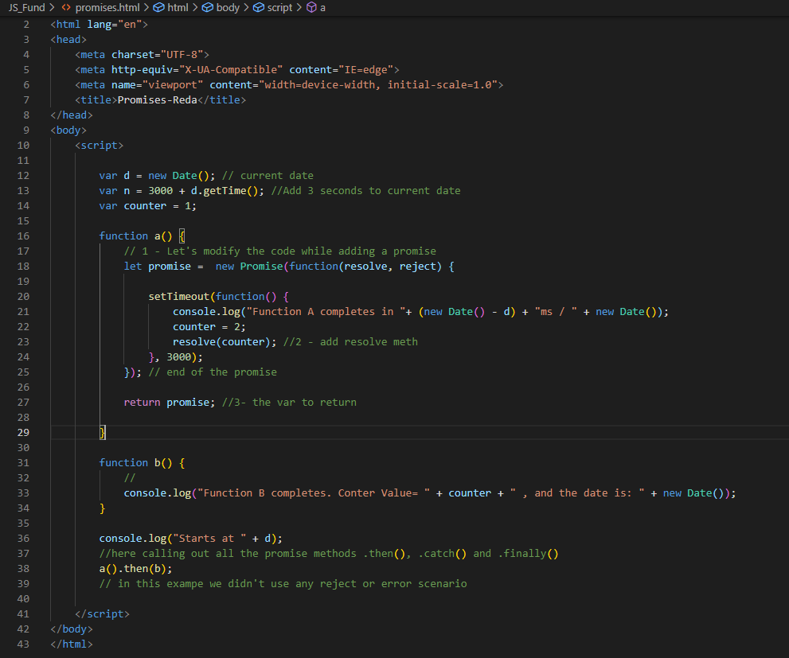
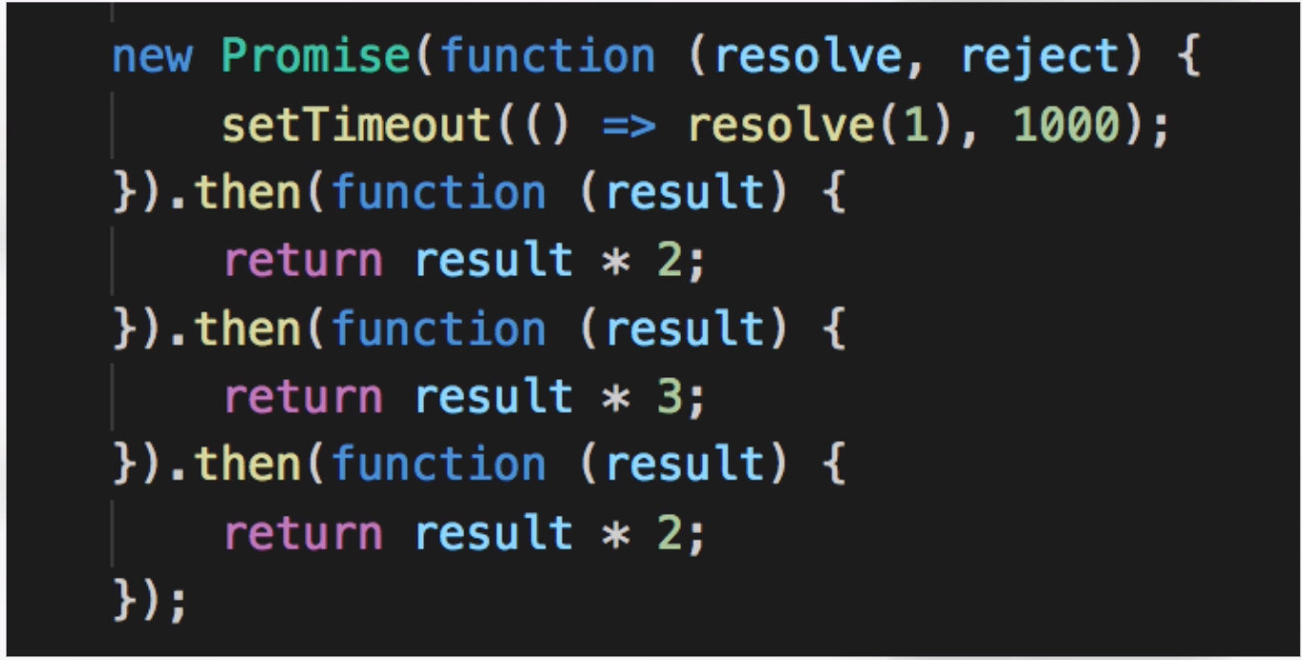
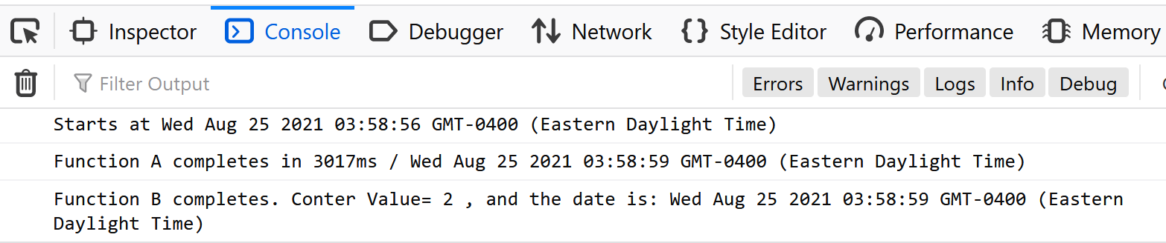
JavaScript Basics: Promises 2
Promise is a most sophisticated solution to implementing asynchronous code in JavaScript
We can also use a chained promises where next function executes if the previous one was successful.

Slide 24
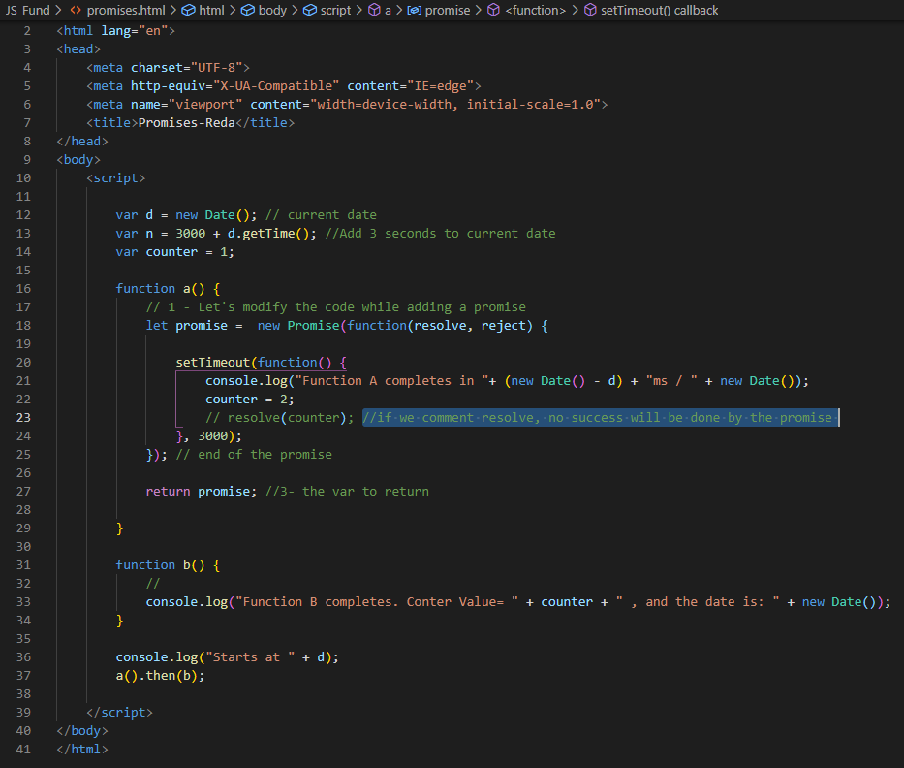
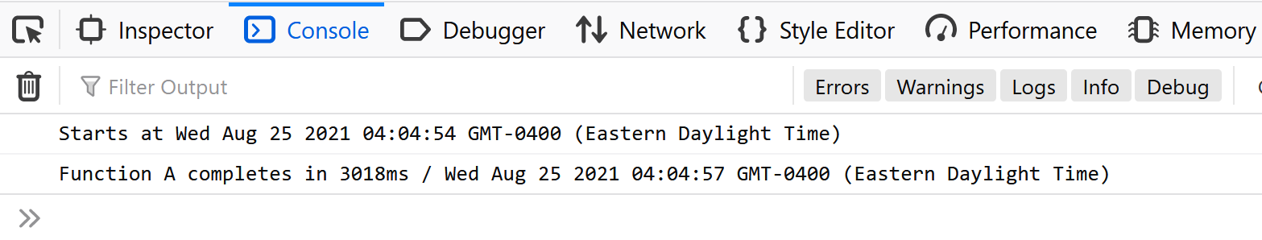
JavaScript Basics: Promises 3
If we comment resolve, no success will be done by the promise
Therefore, function b() won’t be executed

Slide 25
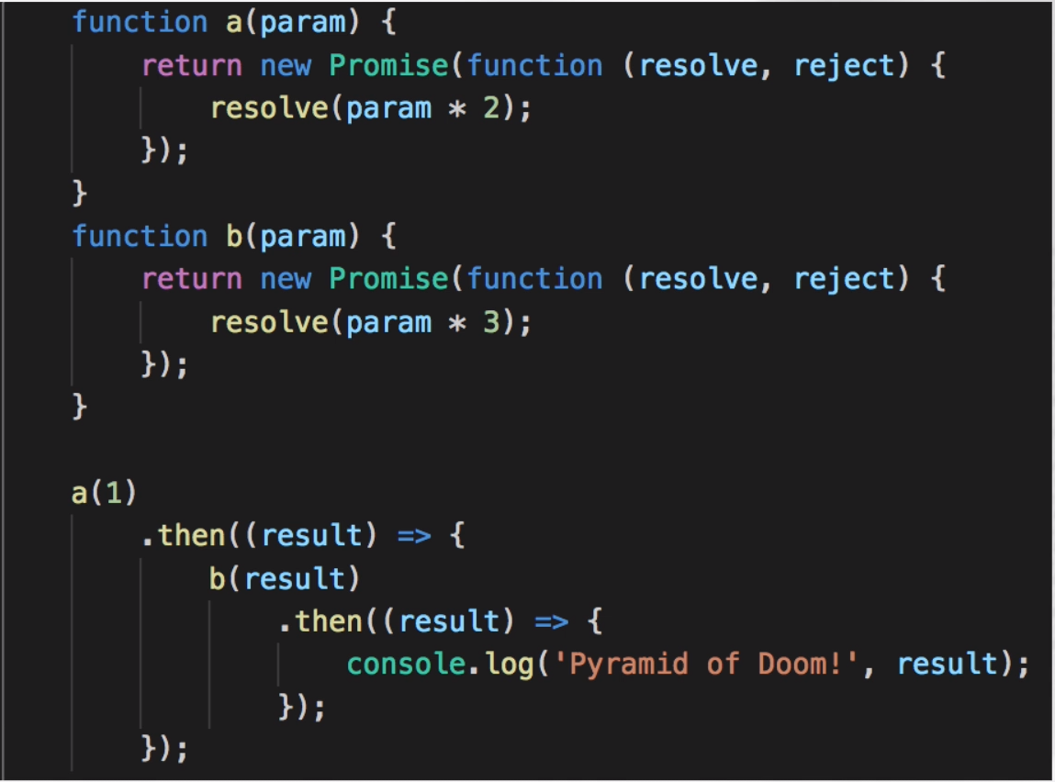
JavaScript Basics: Promises Hell

Slide 26
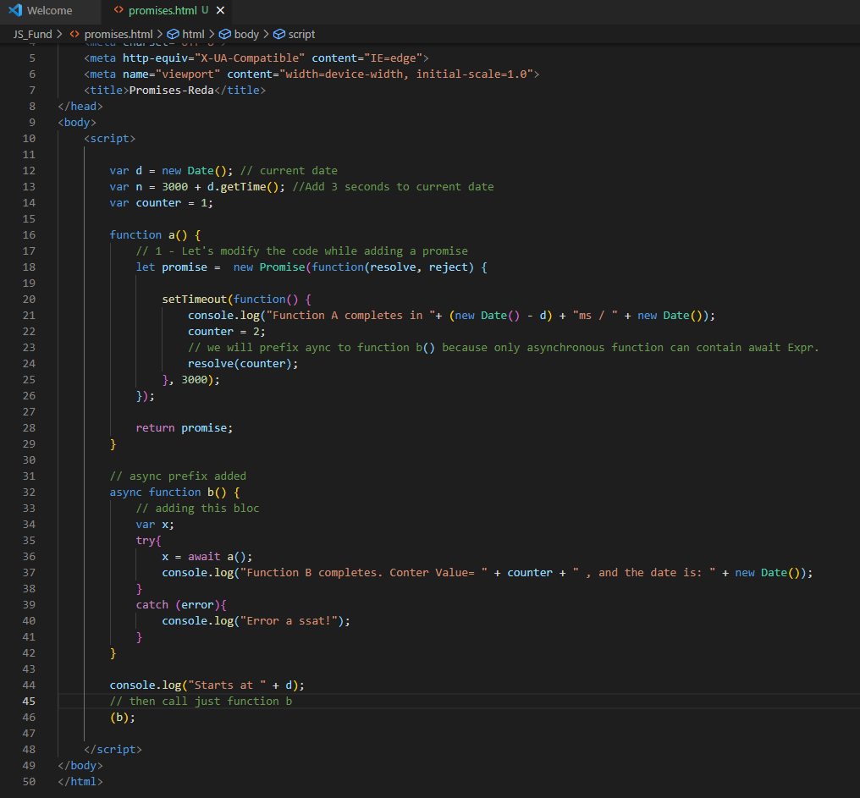
JavaScript Basics: Await Expressions in Aync Functions
Await expression works in an Asynch function
Supported in Lambda for Node.js 8.10
Cleaner code
Used in Lambda Functions, including Alexa Skills
Makes code easier to debug
Execution in sequence
Reliability

Slide 27


Slide 28
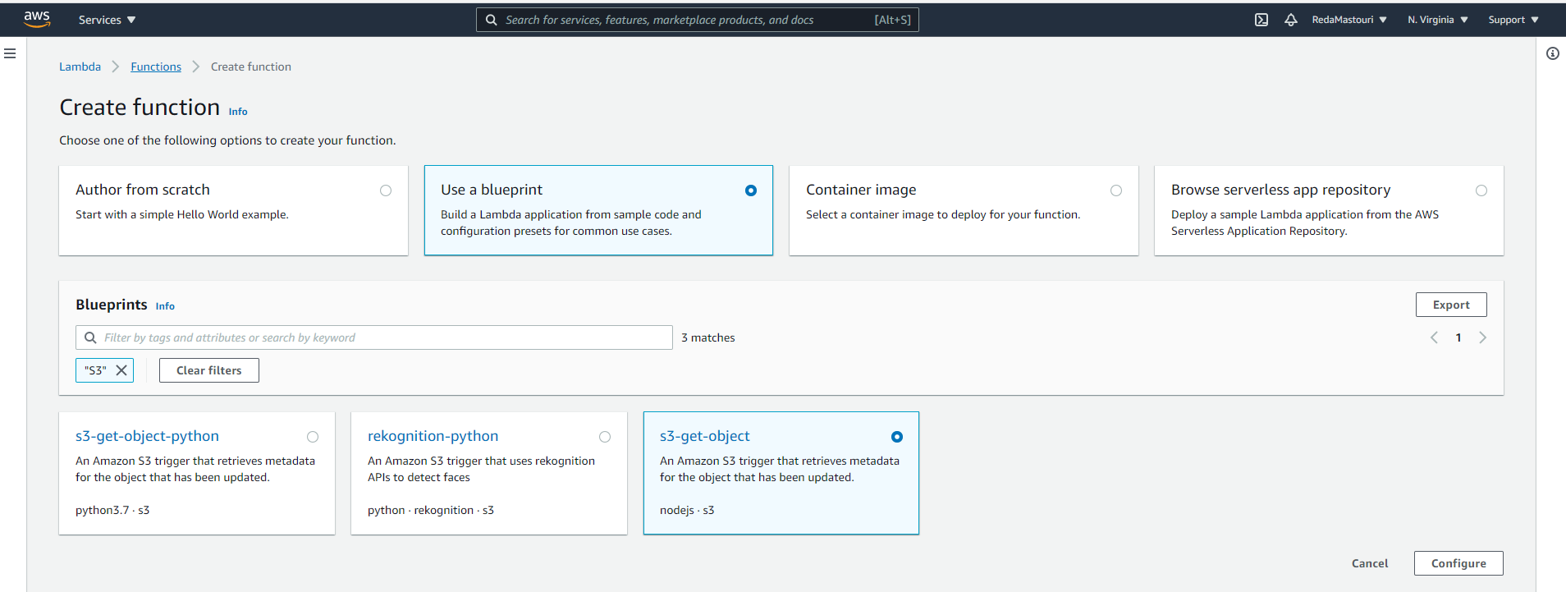
AWS Lambda Basics Create Lambda Function
S3-get-object from Lambda blueprints

Slide 29
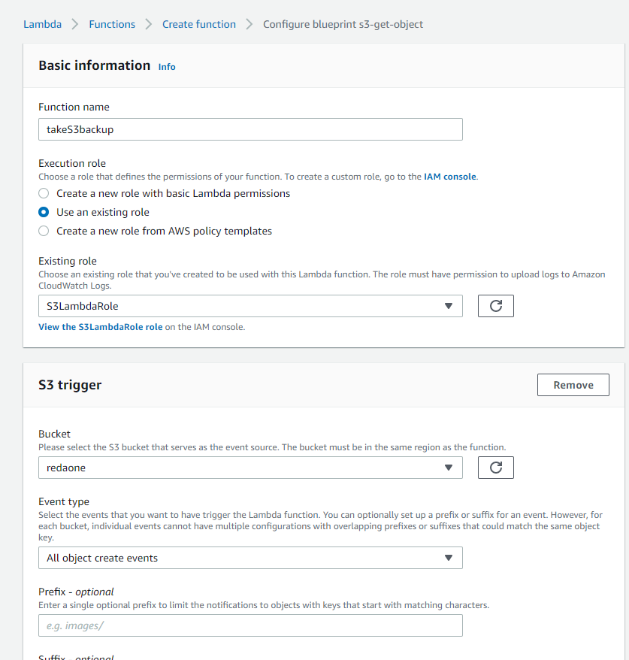
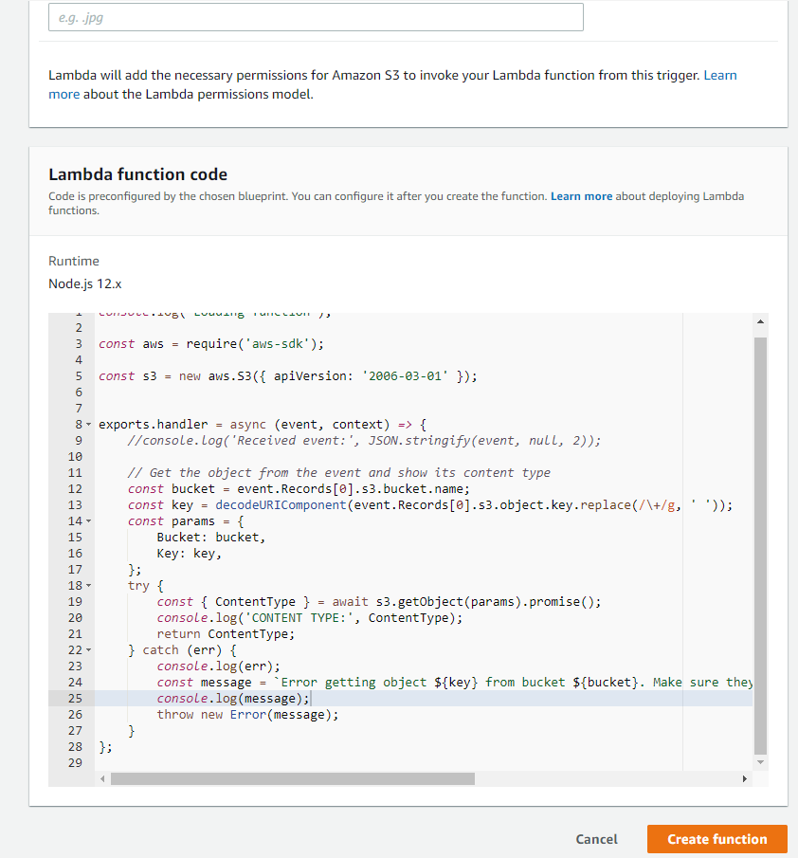
AWS Lambda Basics Create Lambda Function

Slide 30
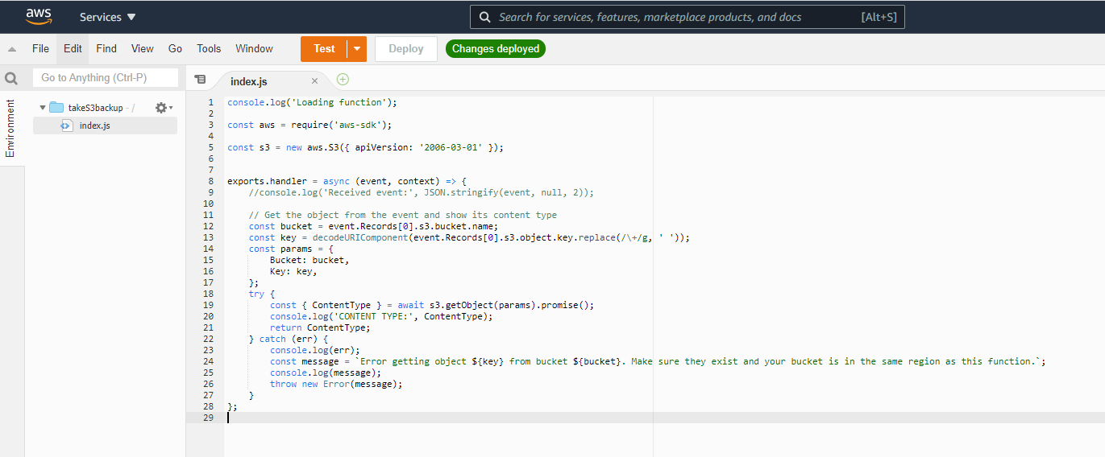
AWS Lambda Basics Create Lambda Function

Slide 31
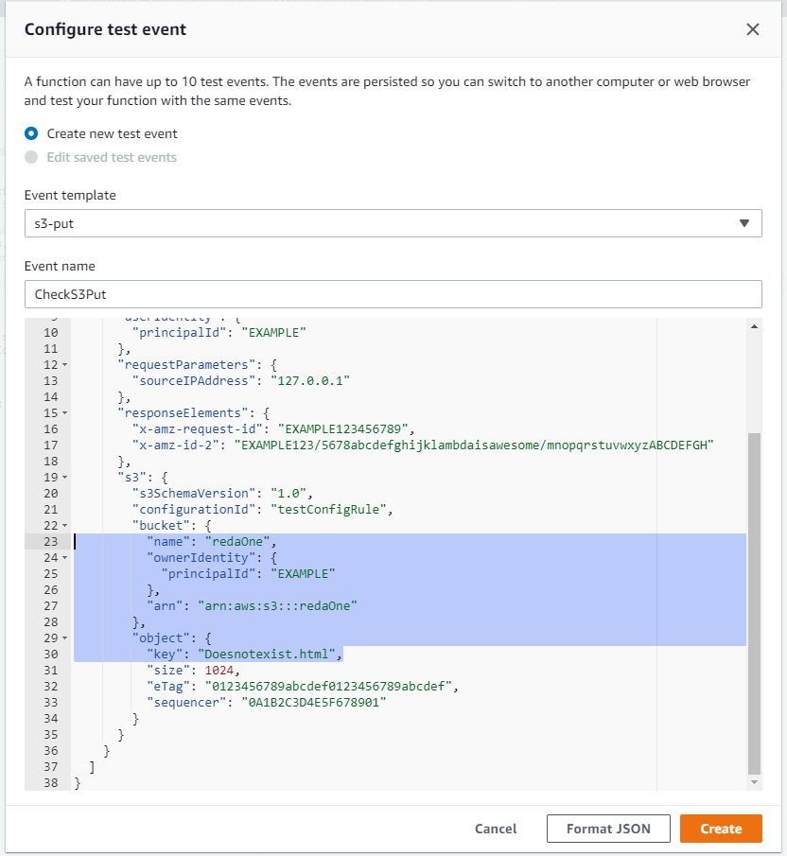
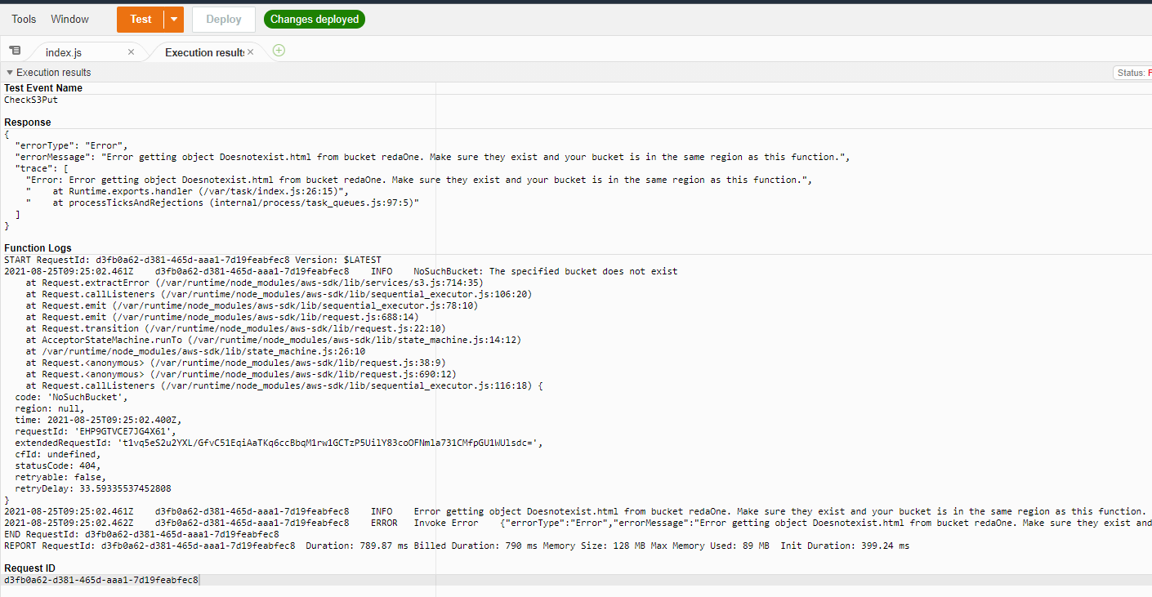
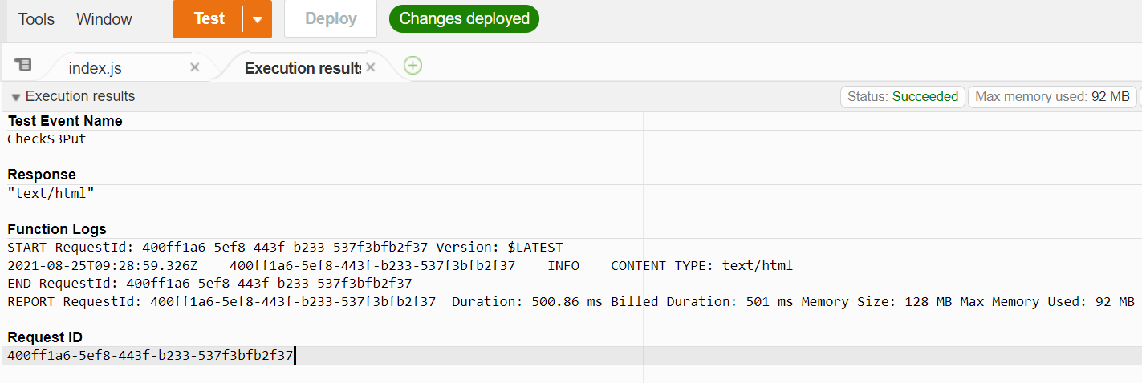
AWS Lambda Basics Prepare Lambda test Event to Check connectivity

Slide 32
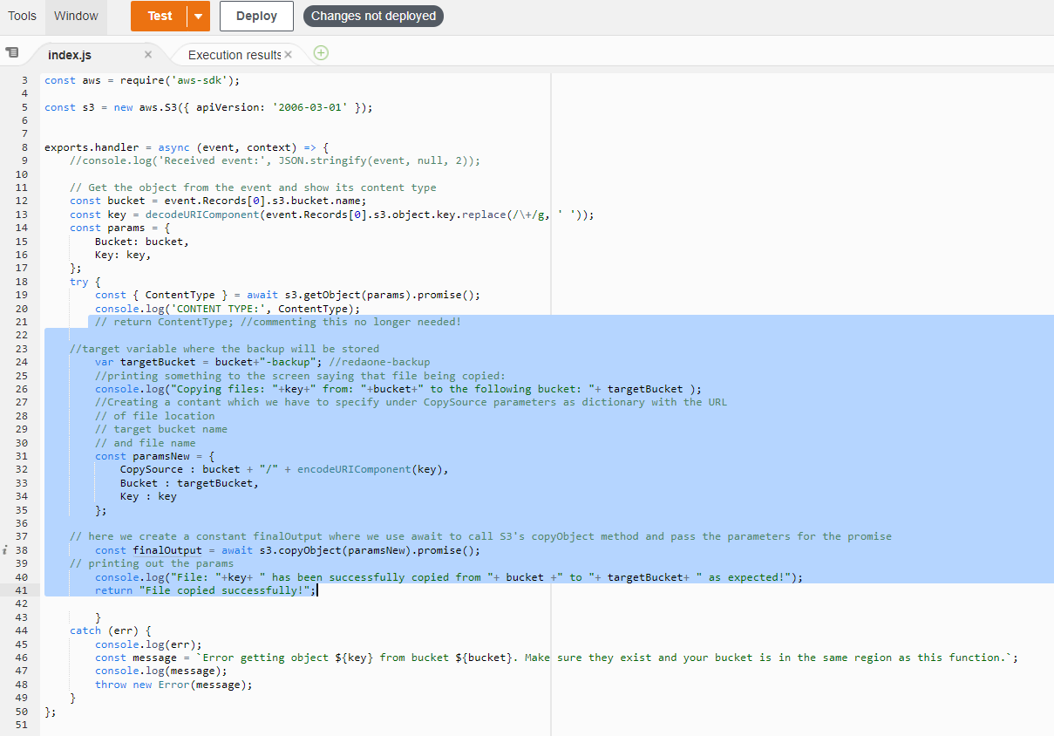
AWS Lambda Basics Upgrade Lambda Function

Slide 33
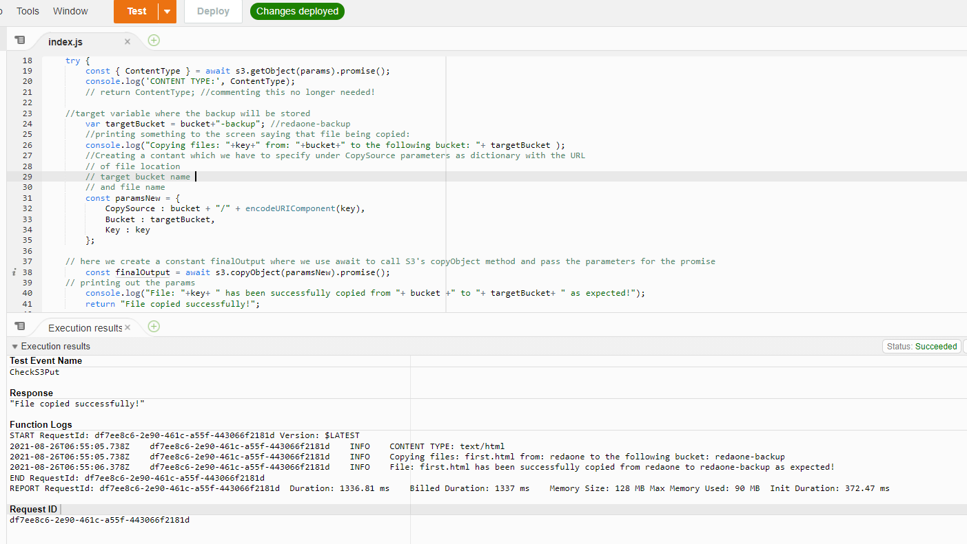
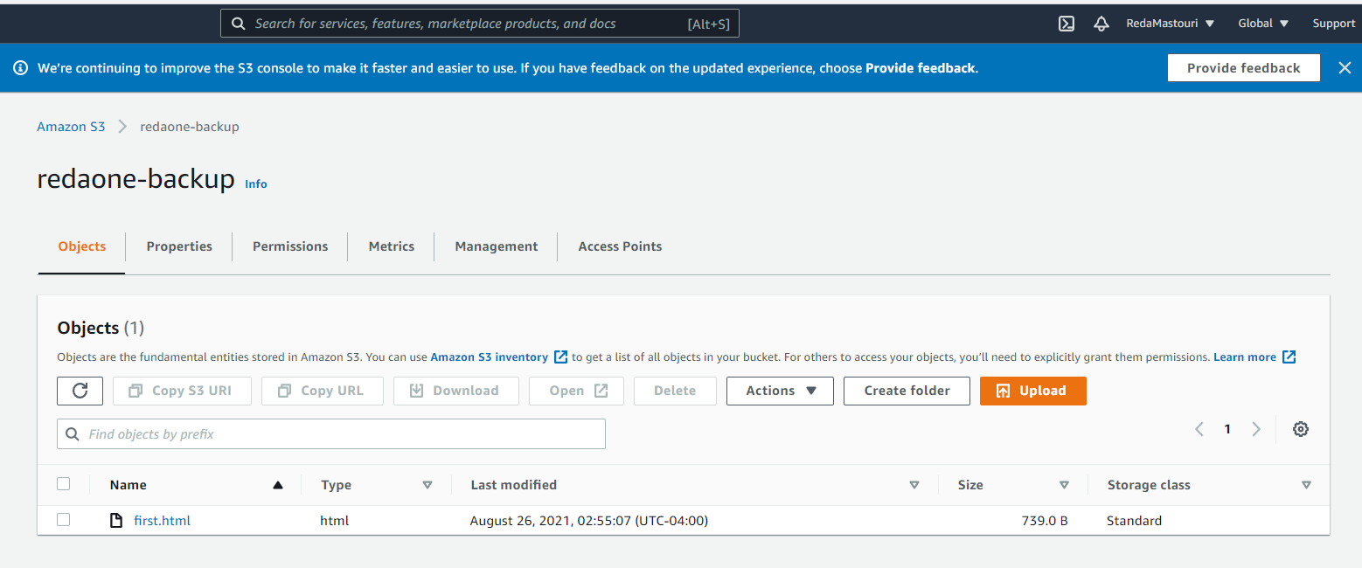
AWS Lambda Basics Testing & Verification

Slide 34


Slide 35

Starting to build a Schedulify Skill Designing a Voice Interaction Model
Invocation Name:
Reda
Job:
Read out Quotes
Example: Alexa, Ask Reda for a quote from Einstein
Example: Alexa, Ask Reda what did Abraham Lincoln say

Slide 36
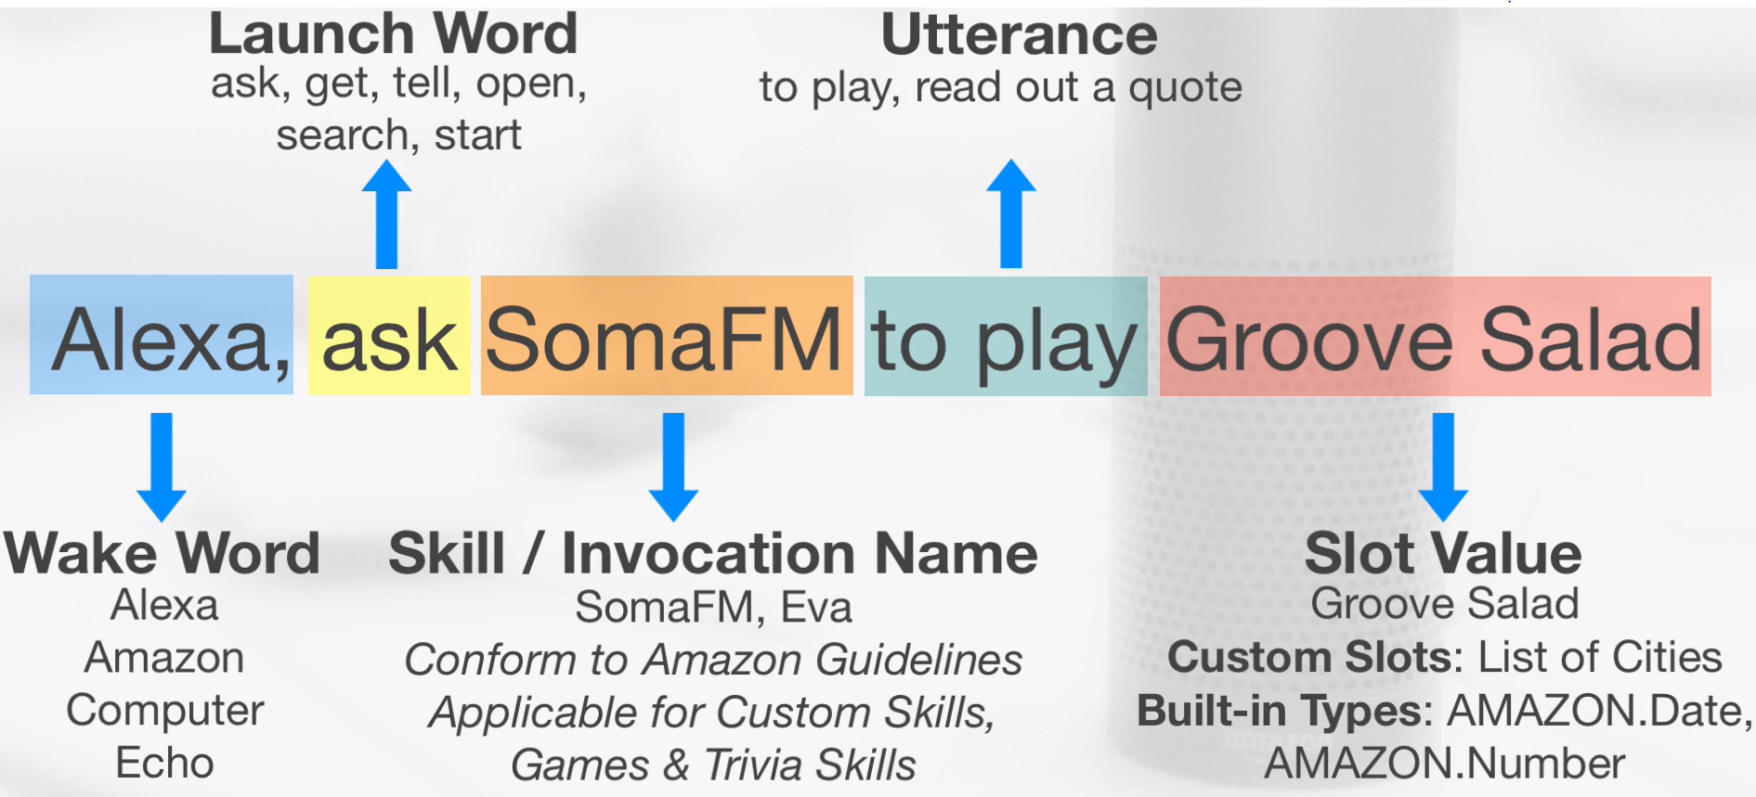
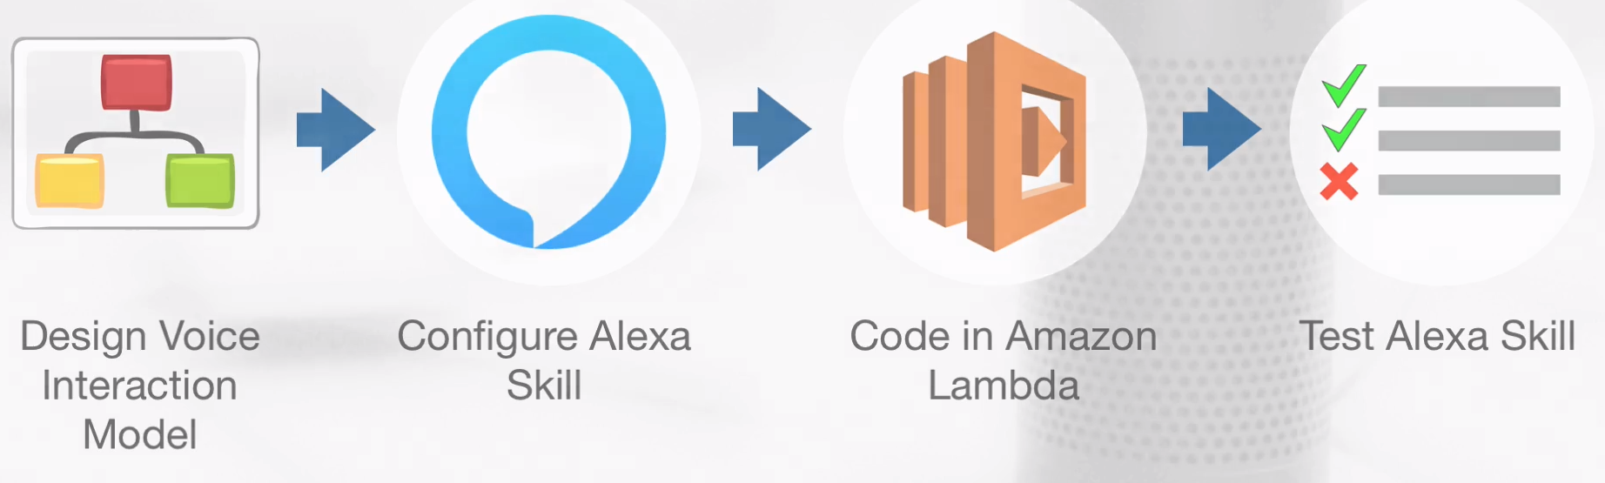
Starting to build a Schedulify Skill Designing a Voice Interaction Model
Step 1: Preliminary work
Create a Voice Interaction Model
Prepare Intents, Slots, and Utterances
Data - Authors and their Quotations
Step 2: Skill Configuration
On Amazon Developer Portal
Step 3: Skill Development
Create a Lambda function
Link Lambda function with Alexa Skill through ARN
Step 4: Skill Testing
Lambda test events
Skill simulator on Developer Portal
Physical device / Amazon Echo

Slide 37
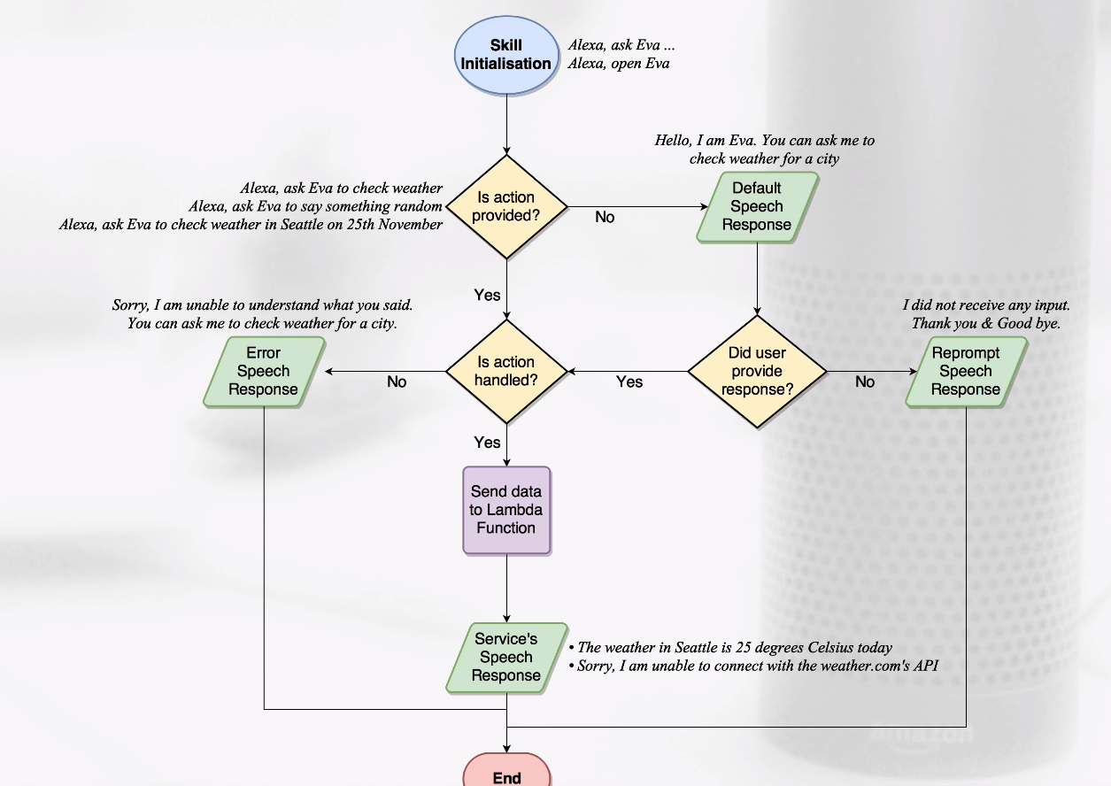
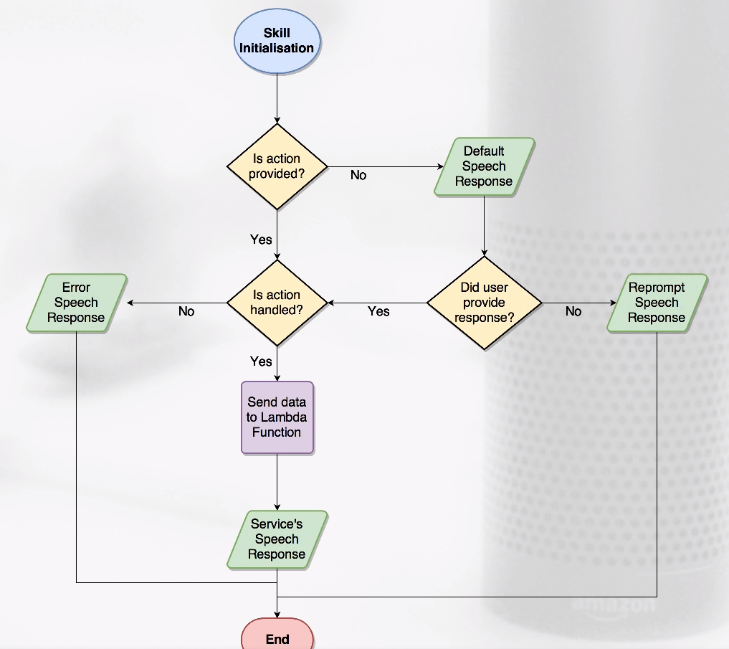
Starting to build a Schedulify Skill

Slide 38
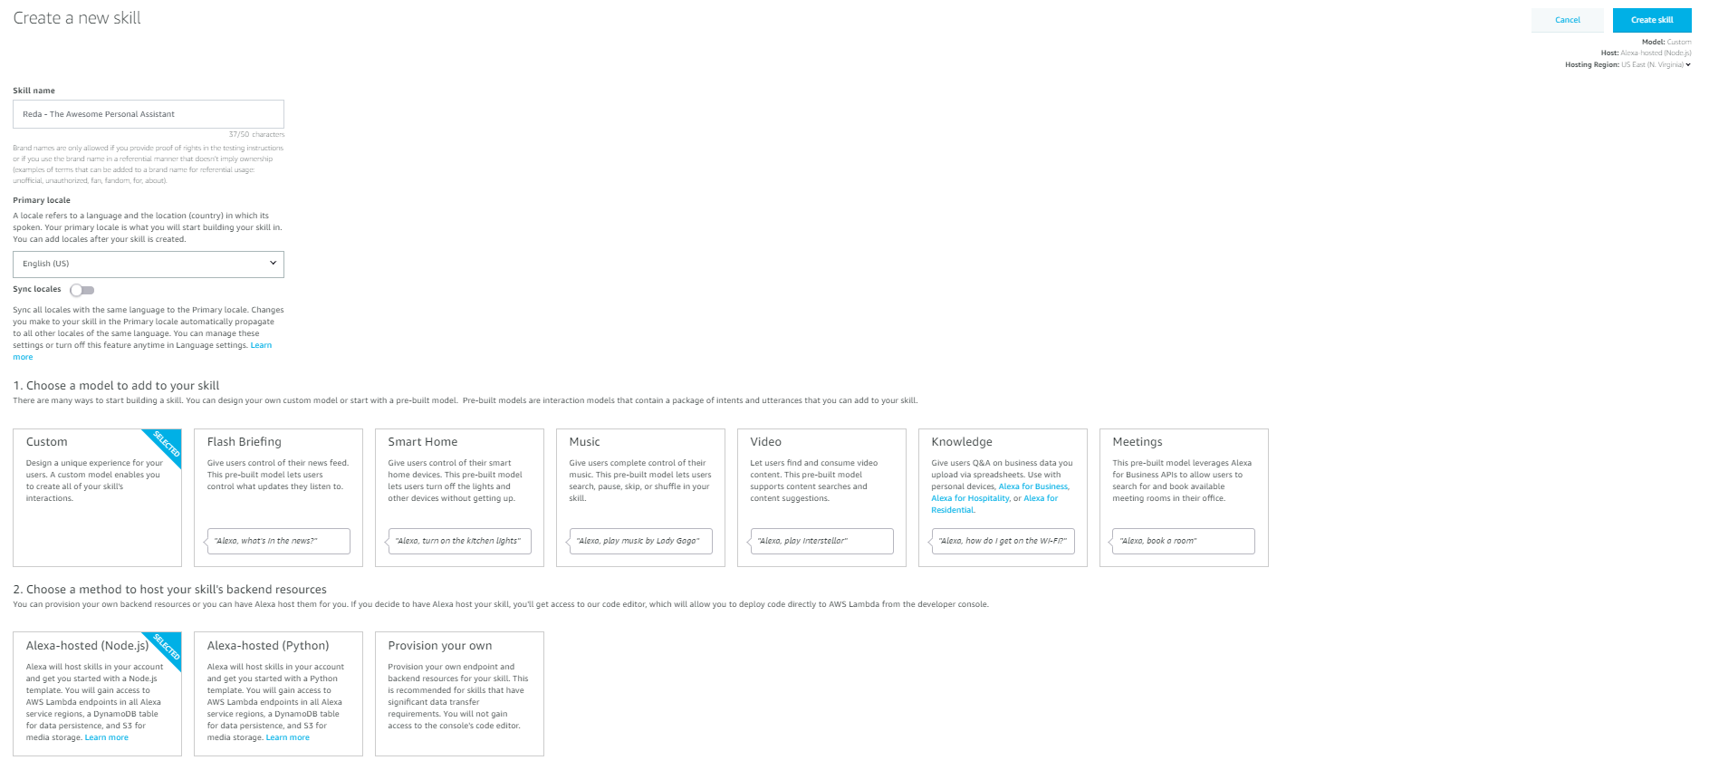
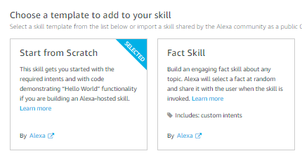
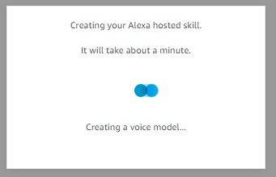
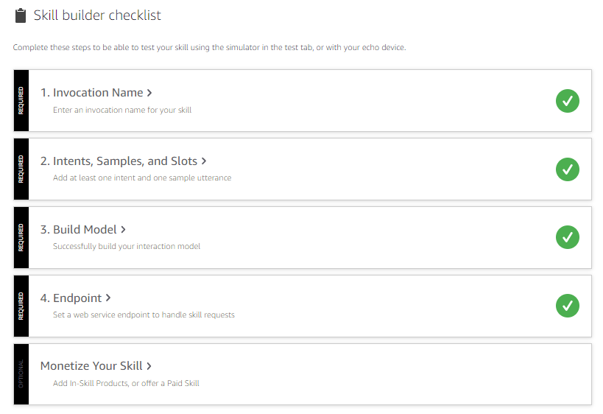
Starting to build a Schedulify Skill

Slide 39




Starting to build a Schedulify Skill Configuration of Reda 1.0 Custom Skill on Dev Portal

Slide 40
Starting to build a Schedulify Skill Request handlers, Response Objects and Builder in Lambda function for Alexa
Request Handlers
Custom handlers: Manage intents
Pre-defined handlers: Provided by Amazon
Intent Request Handlers: Managing intents defined in intents schema
What is done: RandomQuote and AuthorQuote
It is called when Utterance matches Intent Slot Value is passed on if applicable
Pre-defined Request Handlers
Like LaunchRequest: When skill is invoked without any action
Example: Alex, open Reda
Then there is SessionEndedRequest: When an Alexa session ends
Buil-in Intents
Such as AMAZON.HelpIntent: if user opens skill, and asks for help
Need to be provided in the Intent Schema. No sample Utterance required
Response Objects
There are two: Audible Response and Visual Response
Response Objects
There are two: Audible Response and Visual Response
Audible Response Object:
Output Speech Response: A skill reads out a quote
Reprompt Speech Response: Ask user again if no input provided, while maintaining context
Visual Response Object:
For echo show/spot, Alexa app
Cards: they provide Title & Content
Using both Audio and Visual
In lambda function, provide:
Card values
Speech output
Response Builder – ASK v2
Helper methods to construct response
To end conversation: .speak() method
To ask for user’s input: .reporompt() method
To use a card response: .withSimpleCard() and .withStandardCard()

Slide 41


Starting to build a Schedulify Skill Reda bot introducing itself: On AWS Lambda

Slide 42



Starting to build a Schedulify Skill Reda bot introducing itself: On AWS Lambda

Slide 43



Starting to build a Schedulify Skill Reda bot introducing itself: On AWS Lambda

Slide 44

Starting to build a Schedulify Skill Testing Reda Skill Bot

Slide 45
Starting to build a Schedulify Skill Extending Lambda function to achieve first goal
// Include the Alexa SDK v2const Alexa = require("ask-sdk-core");// The "LaunchRequest" intent handler - called when the skill is launchedconst LaunchRequestHandler = { canHandle(handlerInput) { return handlerInput.requestEnvelope.request.type === "LaunchRequest"; }, handle(handlerInput) { const speechText = "Hi Fulcrum Digital associates! Let me introduce myself.. I am Reda. I am glad to be proudly engineered, to serve you!.. Please, le me know how I may help you"; // Speak out the speechText via Alexa return handlerInput.responseBuilder.speak(speechText).getResponse(); }};// Register the handlers and make them ready for use in Lambdaexports.handler = Alexa.SkillBuilders.custom() .addRequestHandlers(LaunchRequestHandler) .lambda();

Slide 46


Slide 47
Starting to build a Schedulify Skill
Revenue
Expenditure
Generating revenue
Culinary suite

Slide 48

Next .. Engage your customers with an Alexa skill
Companies large and small are building Alexa skills to capitalize on this growing opportunity — there are now more than 30,000 skills published in Amazon’s catalog.
FulcrumOne team of Alexa developers can help your company extend your digital reach through a custom skill on millions of Amazon Echo devices.

Slide 49
Wrapping Up
In a voice-first world, Alexa, Google Assistant, Siri, and other AI-enabled assistants will be a powerful marketing medium. It can combine sales and distribution channel, fulfillment, and service center. Following the gold rush of building brand mobile apps, the current trend is building branded skills for voice assistants.
The increasingly capable voice assistants will be reshaping the brands’ and retailers’ connections with customers. The consumers’ allegiance will be shifting from trusted brands to a trusted platform that helps them navigate the ocean of choices. Re-ordered essentials will be flowing to households like water or electricity. Growing creative audio content will advertise without annoying and alienating listeners. The AI will gather information about the consumers’ preferences to improve the shopping experience and offer the portal to a boundless marketplace of entertainment, news, goods, and services. Amazon Alexa is sure to be one of those platforms.
For publishers, music services, and smart-home tech companies, custom Alexa skills seem to be a must for increasing engagement with millions of users. Other company managers and marketers should consider creating a branded skill as well: it offers a natural way to introduce a brand to potential consumers and abundant opportunities for product improvement, marketing, and advertising, and helps cultivate customer loyalty.

Slide 50
References
How do Alexa Skills work?: https://chatbotsmagazine.com/how-does-alexa-skills-works-82a7e93dea04
ASK Documentation: https://developer.amazon.com/en-US/docs/alexa/custom-skills/understanding-custom-skills.html
How does your brand benefit from developing an Alexa Skill?: https://www.deligence.com/blog/benefit-from-developing-an-alexa-skill/
Practical Hands-on Guide for Alexa Skill Development (2020): https://fulcrumdigital.udemy.com/course/build-your-rad-personal-assistant-with-amazon-alexa-custom-skills/

